Slide 1


Collaborative Business Intelligence
Kevin Burrus
Brainspire Solutions
Kevin@Brainspire.com
847-338-2956
www.Brainspire.com

Slide 2
When you think of Collaborative Business Intelligence what do you see?

Slide 3
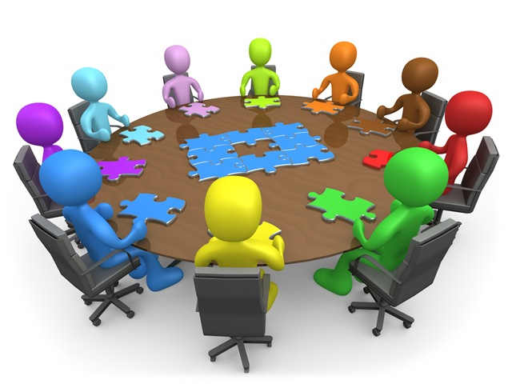

Slide 4


Let’s think about the typical process for taking on new data sources
As new data sources are identified, requests go to IT to turn raw data into a report/model/etc…
… and business teams use this data to improve processes, and identify SWOTs
Business
IT
Notes:
Usable information all depends.

Slide 5


But with bigger data, in both size and format, the squeeze of having only a central workflow can end up looking at lot more like this:
Business
IT
Notes:
We have budget stress, resource stress, and missed opportunities for businesses to do something better as a result of new insights.

Slide 6
So we have the start of our bottleneck. Multiple departments, multiple needs, and one path.
IT
Warehouse
Marketing
Sales
Business Process
Call Center
Finance
Notes:
Financial departments will specific financial reporting capabilities

Slide 7


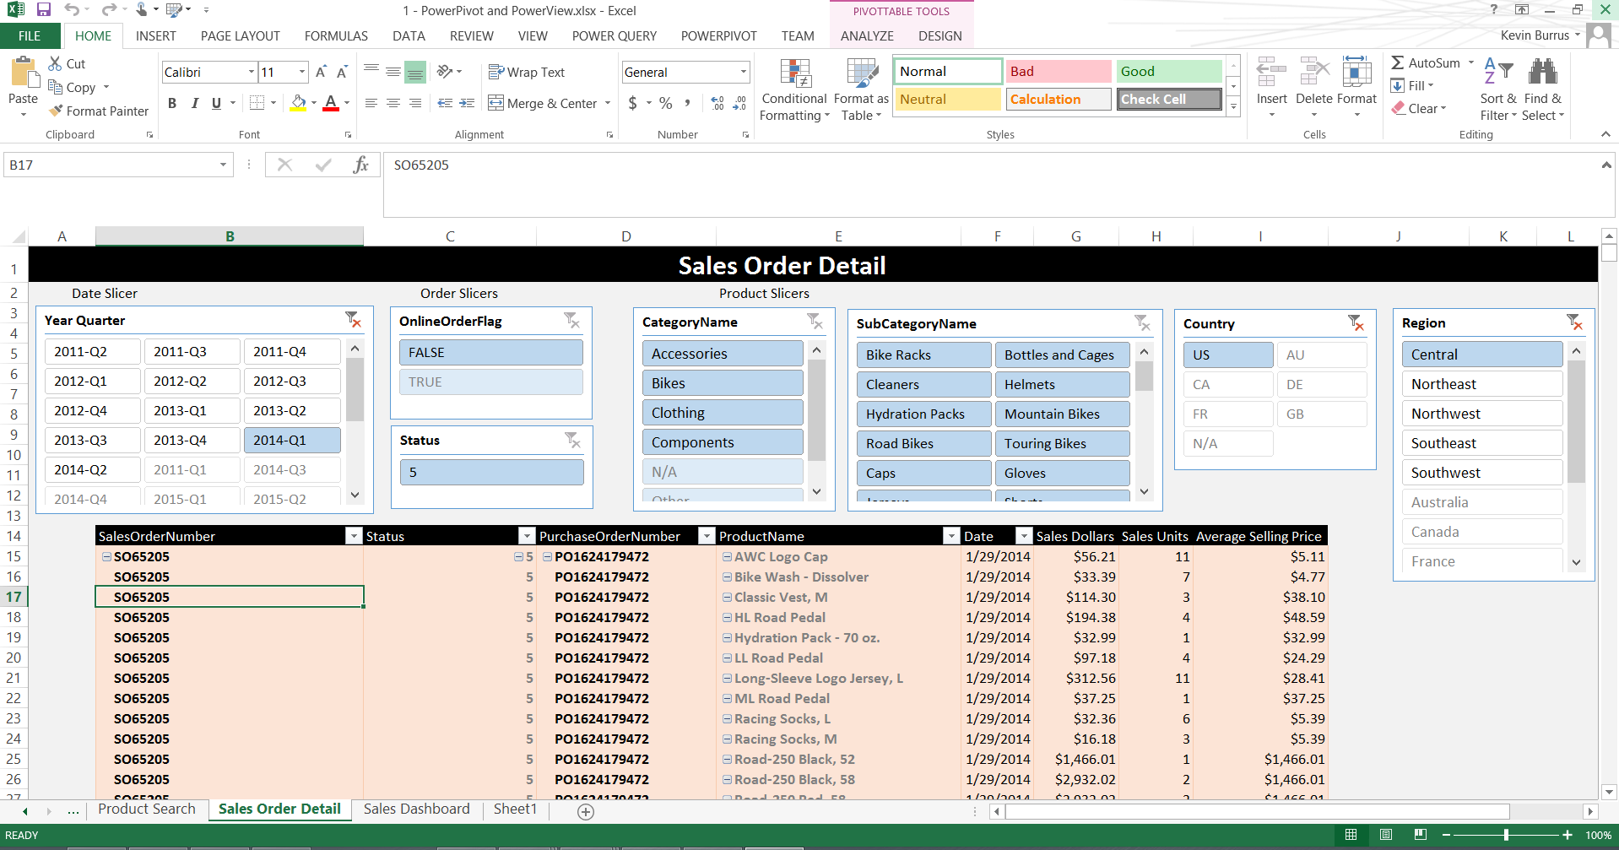
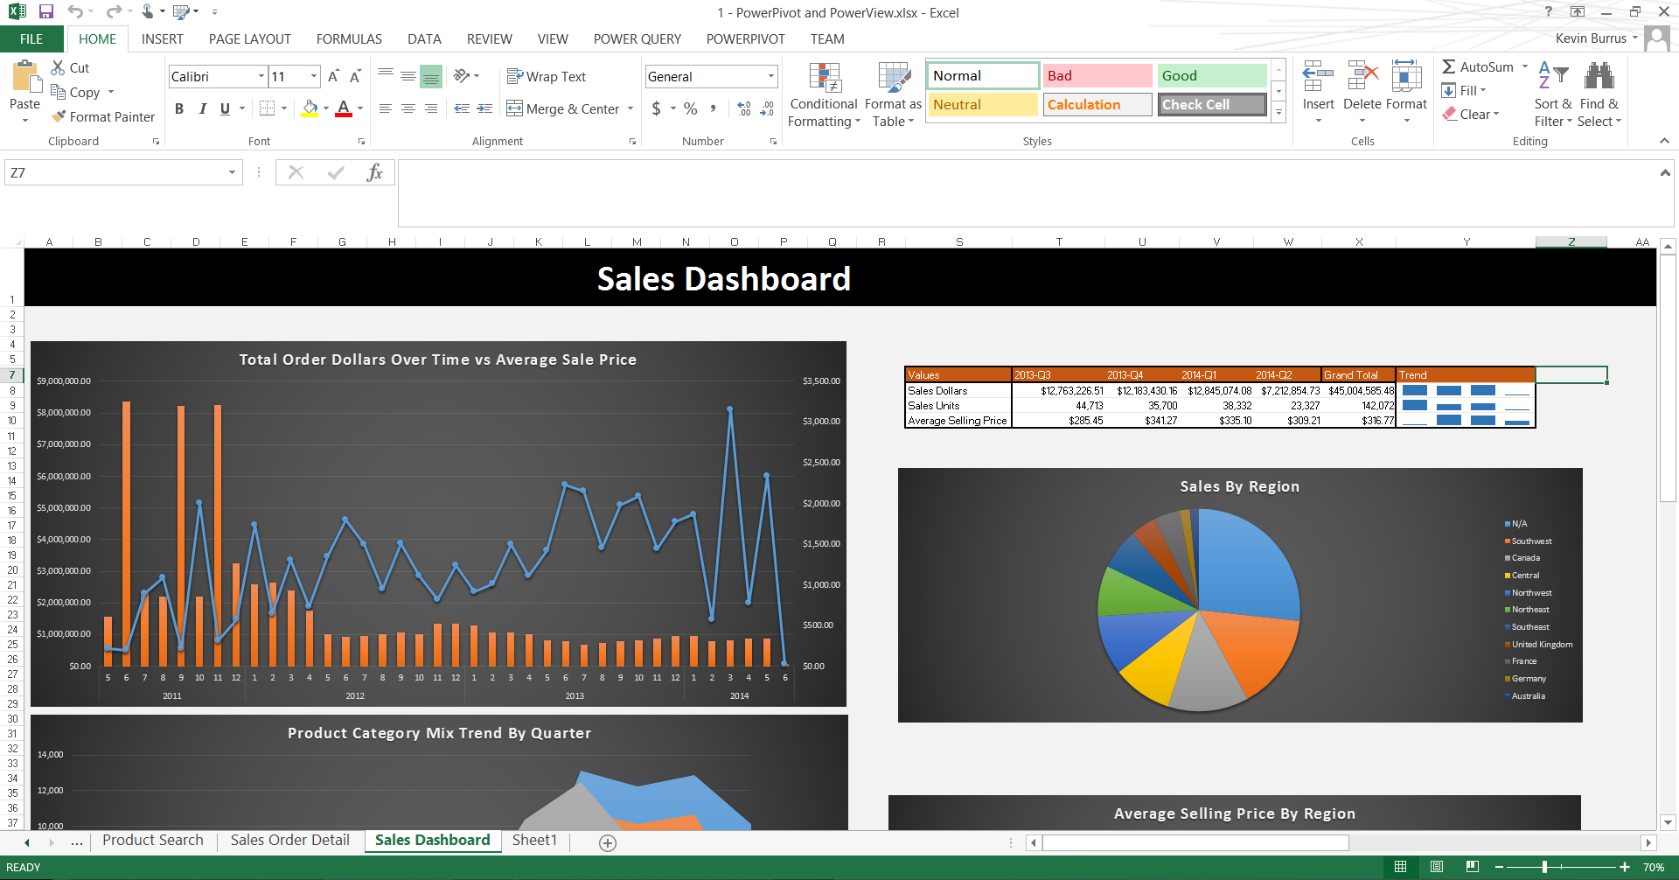
Many businesses, pushing to gain insights faster, will decouple specific needs and functions from this central process.
IT
Warehouse
Marketing
Sales
Business Process
Call Center
Finance
Notes:
Take an example:
Some of external products are so extremely time savings that it wouldn’t make sense not to use them.
Others are kind of left behind. Users who may not know the right question to ask (due to lack of access to data), may never get
Still other processes, and what I like to call the “human data integrator” pops up creating models that can’t scale to supporting more than 1 desktop effectively. Excel Hell!

Slide 8

After this process of isolation kicks in, a timely question is asked
Oh, and I need it daily for it to be truly useful!
Bob, can you just pull this manually every day too?
What are my forecast (manual) vs actual (automated) sales?
Can we see this against marketing efforts as well??
Notes:
We have budget stress, resource stress, and missed opportunities for businesses to do something better as a result of new insights.

Slide 9

When these reports hit limitations (Frequency, Scalability, Extensibility), large projects are formed to migrate desktop process automations to a central store
Officially buried!!
Notes:
We have budget stress, resource stress, and missed opportunities for businesses to do something better as a result of new insights.

Slide 10


What’s wrong with this? Money and time are too things business cannot afford to waste.
Notes:
We have budget stress, resource stress, and missed opportunities for businesses to do something better as a result of new insights.

Slide 11
So, how can we allow for enough flexibility so that businesses can more quickly answer their own questions in a way that scales?

Slide 12

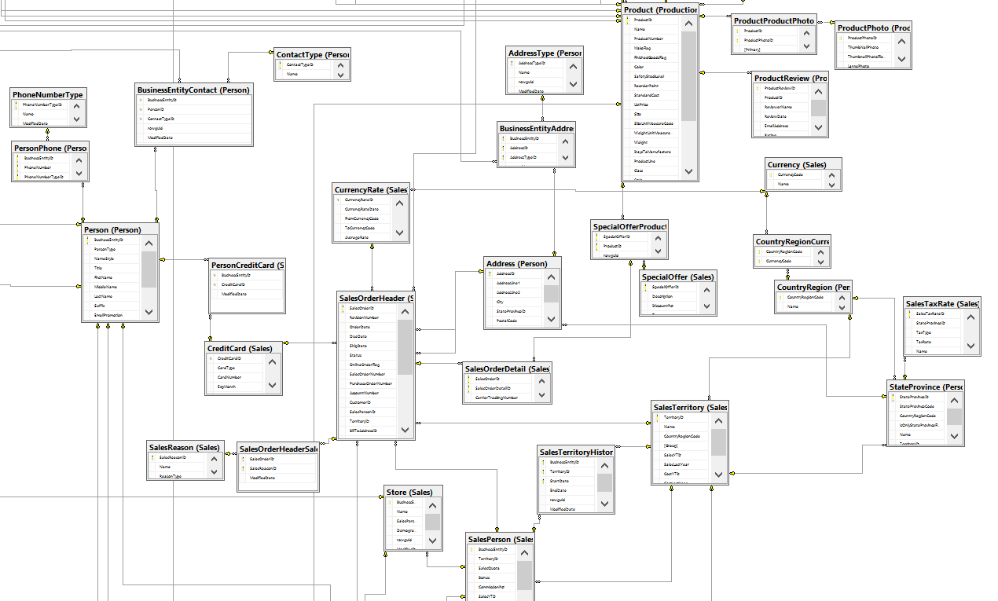
Consider a sample problem, and let’s walk through the collaborative business intelligence process
Your company is just getting started and are in the initial phase of a new ERP release. You know about a few reports that will be needed, but there are still a lot of unknowns around what is available and useful.
…and we cant exactly throw end users directly into this!

Slide 13
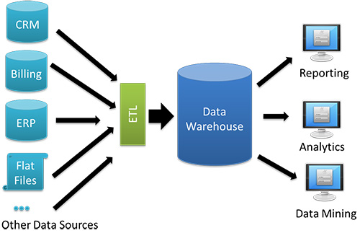
Consider a sample problem, and let’s walk through the collaborative business intelligence process
So how do we handle the need?
Path 2:
Build a few standard canned reports
Path 1:
Start building out a data warehouse

Slide 14
Let’s consider a third option: Build functional models first using in-memory models
What alternatives do we have? With current self-service tools and capacity for workbook reports to be promoted to team and enterprise solutions, what if we created a functional in-memory model first, directly from the raw data sources? (yes, use replication databases if possible!)
Path 3:
Model analytical data in memory first, and promote as needed
Self-Service
Team BI
Enterprise
World Class
1.) Use PowerPivot for Excel for initial prototype
2.) Promote to PowerPivot for SharePoint for Team self-service BI
3.) Promote to Tabular SSAS
4.) Use well defined and adopted data sources as primary intake for Data Warehouses

Slide 15
First-adopters cycle through their data models and help find outliers and opportunities in data
Step 1: Start Small, Move Fast
IT helps build a base dimensional model and typically creates the SQL to pump data from relational to dimensional format. This is best done side-by-side our first adopters.
Analysts are free to generate measures using DAX, and excel-like language and can build out dashboards, flat reports, and rich Power View apps
Isolation of logic allows for rapid deployments of business logic changes
Iterate, Iterate, Iterate!

Slide 16
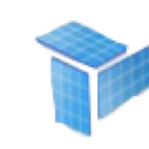


Some models unlock real business value and need the scale of an enterprise solution
Upgrade Path to Enterprise
Step 3:
Iterate, Iterate, Iterate!
Notes:
What did that first step just buy us?
Knowledge of what the source data looks like and insights to unknown exceptions
A data model that can be promoted to Tabular SSAS through a wizard process for frequent scheduling, Row-level security, and extensibility for integration with other BI tools like Tableau and Reporting Services (Among others)
A starter, in-memory data mart with multiple reporting capabilities right from the start
Smarter power-users with access and knowledge of better data tools that can scale (Rather than macros/vlookup excel-hell)

Slide 17
Collaborative business intelligence pulls both business and IT closer in both knowledge and relationships
IT can use one-on-one time with analysts to get closer to understanding business needs
ETL
SSIS
Informatica
Data Modeling
OLAP
PowerPivot
Reporting
Excel
Reporting Services
Tabular
Power Query
Tableau
Analytics and Action
Feedback loops for business
Business users are introduced to modeling concepts and are able to apply scalable tools to data discovery missions
Notes:
What did that first step just buy us?
Knowledge of what the source data looks like and insights to unknown exceptions
A data model that can be promoted to Tabular SSAS through a wizard process for frequent scheduling, Row-level security, and extensibility for integration with other BI tools like Tableau and Reporting Services (Among others)
A starter, in-memory data mart with multiple reporting capabilities right from the start
Smarter power-users with access and knowledge of better data tools that can scale (Rather than macros/vlookup excel-hell)

Slide 18

Questions?

Slide 19
Brainspire’s services are focused on custom software solutions that drive our client’s businesses
Our Services
Brainspire develops custom software solutions to meet each client’s individual needs.
Leveraging the Agile Methodology, we believe in demonstrating iterative progress towards our client’s goals. This methodology enables our clients to make better decisions because they always know exactly where their project stands, all tasks left to accomplish, any outstanding risks and detailed budget information.
We also believe in leveraging our cloud environment & project framework for quick and inexpensive project ramp-up and productivity
Service Offerings
Custom Application Development
Designing, developing and integrating custom application solutions typically using Microsoft .NET or Java EE frameworks
Data / Business Intelligence
Developing and improving enterprise level data stores and reporting solutions, including custom dashboards and KPI reports to support decision making
Mobility
Developing mobile device specific or mobile web applications to meet your specific business needs
Systems Integration
Developing and implementing integration solutions to link legacy or “siloed” systems and provide a foundation for future development
Portals / Websites
Custom Intranet, Extranet and Internet portals and websites to streamline employee productivity, enable effective partnering and engage customers using Microsoft’s SharePoint and common open source Content Management Systems

